Slide 1
AIRLINE ANALYSIS
IST687 Group 1
Aditya Kini,Yujing Yuan,Ushma Desai,Praneshwar Srinivasan

Slide 2
CONTENTS
Business Questions
Data Description
Analysis Techniques
Insights and Recommendation

Slide 3
BUSINESS QUESTIONS
Q1. Who are the happy customers or unhappy customers?
Q2. What makes a successful flight experience?
Q3. How to make customers happy?

Slide 4
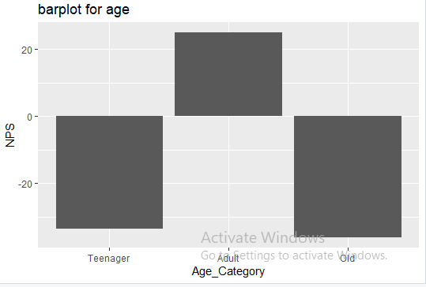
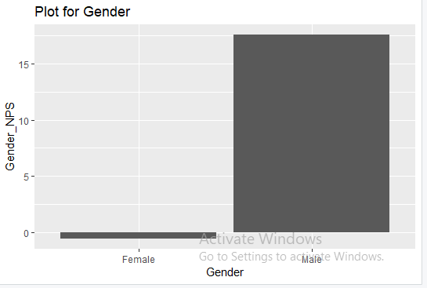
DATA DESCRIPTIONS
Customer Attributes: Age,Gender,Class,Partner

Slide 5
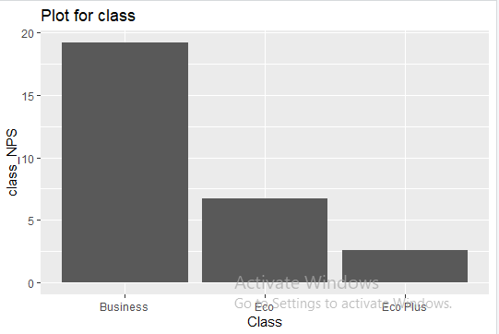
DATA DESCRIPTIONS
Customer Attributes: Age,Gender,Class

Slide 6
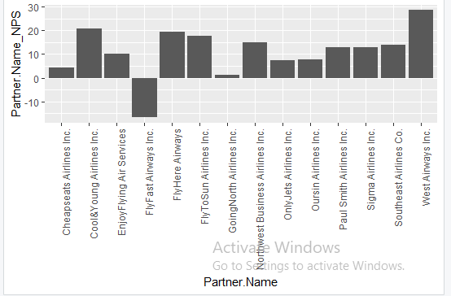
DATA DESCRIPTIONS
Flight Experience Attributes: Partner Airlines,Arrival Delay and Departure Delay

Slide 7
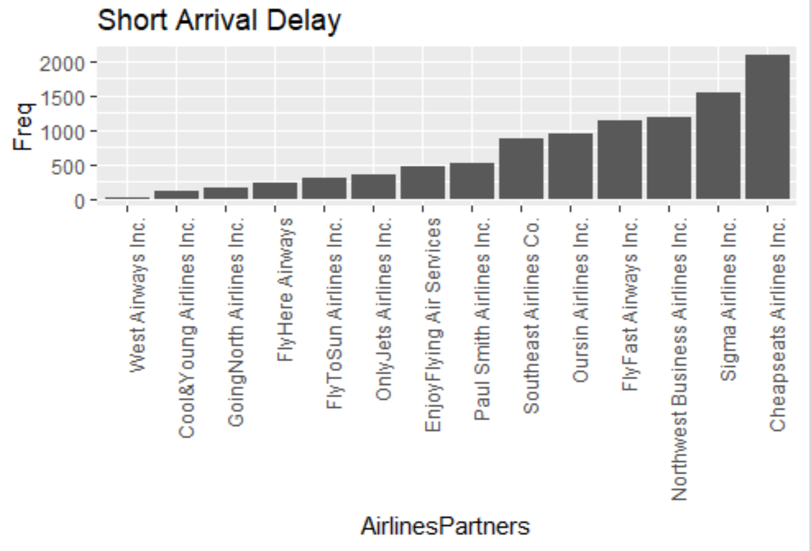
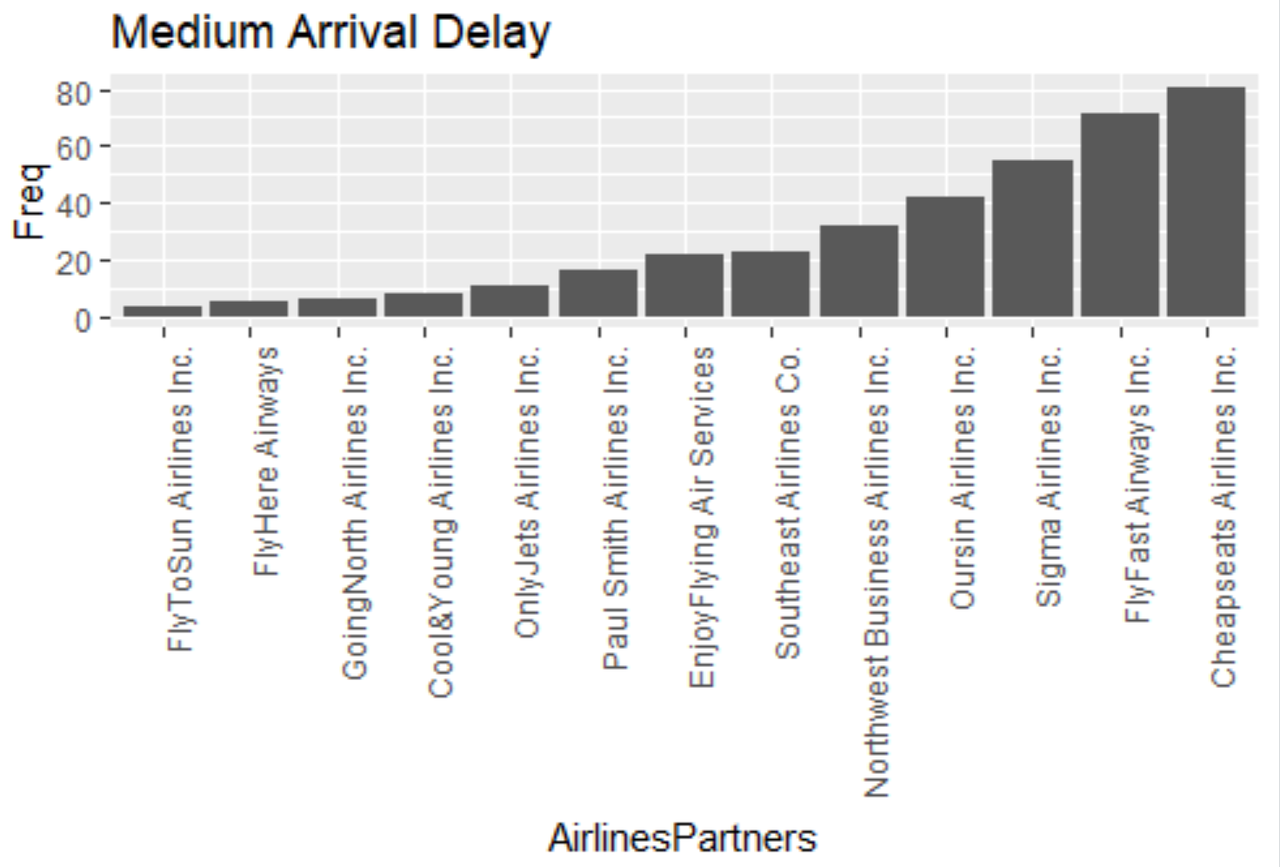
DATA DESCRIPTIONS
Flight Experience Attributes: Partner Airlines,Arrival Delay and Departure Delay

Slide 8
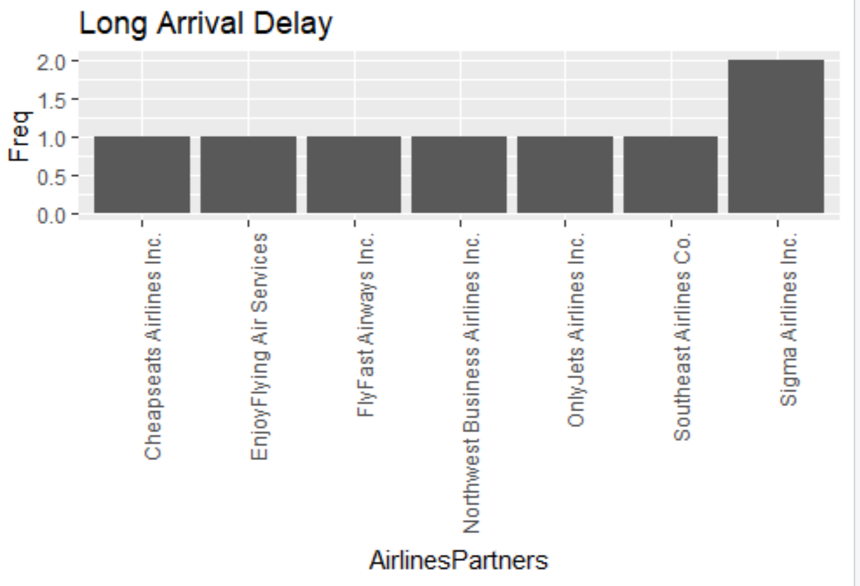
DATA DESCRIPTIONS
Flight Experience Attributes: Partner Airlines,Arrival Delay and Departure Delay

Slide 9
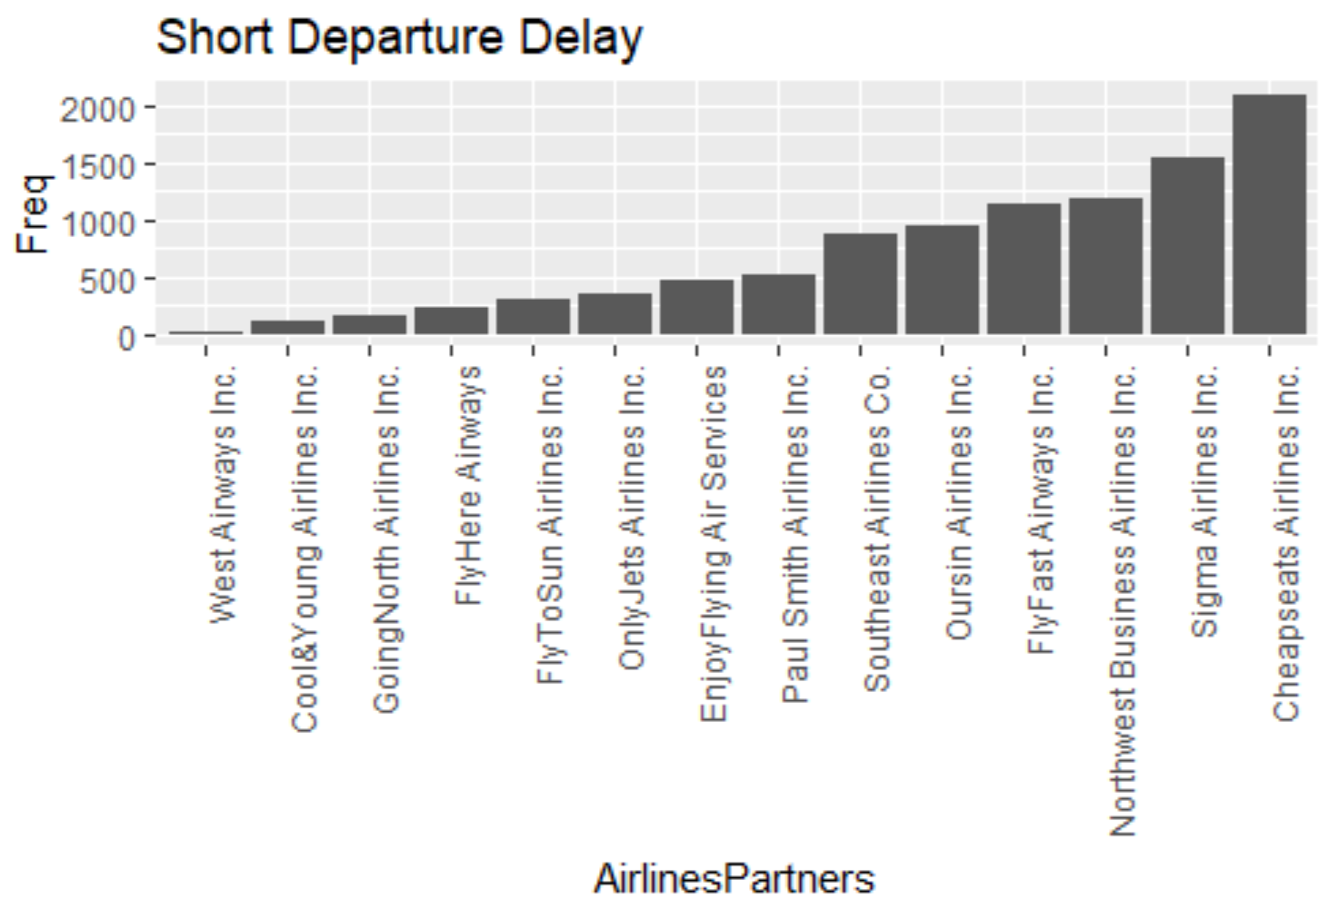
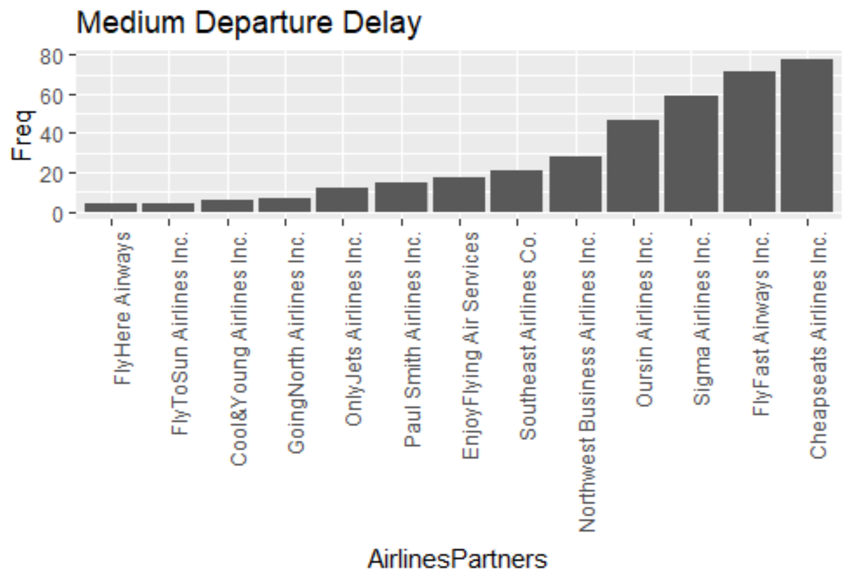
DATA DESCRIPTIONS
Flight Experience Attributes: Partner Airlines,Arrival Delay and Departure Delay

Slide 10
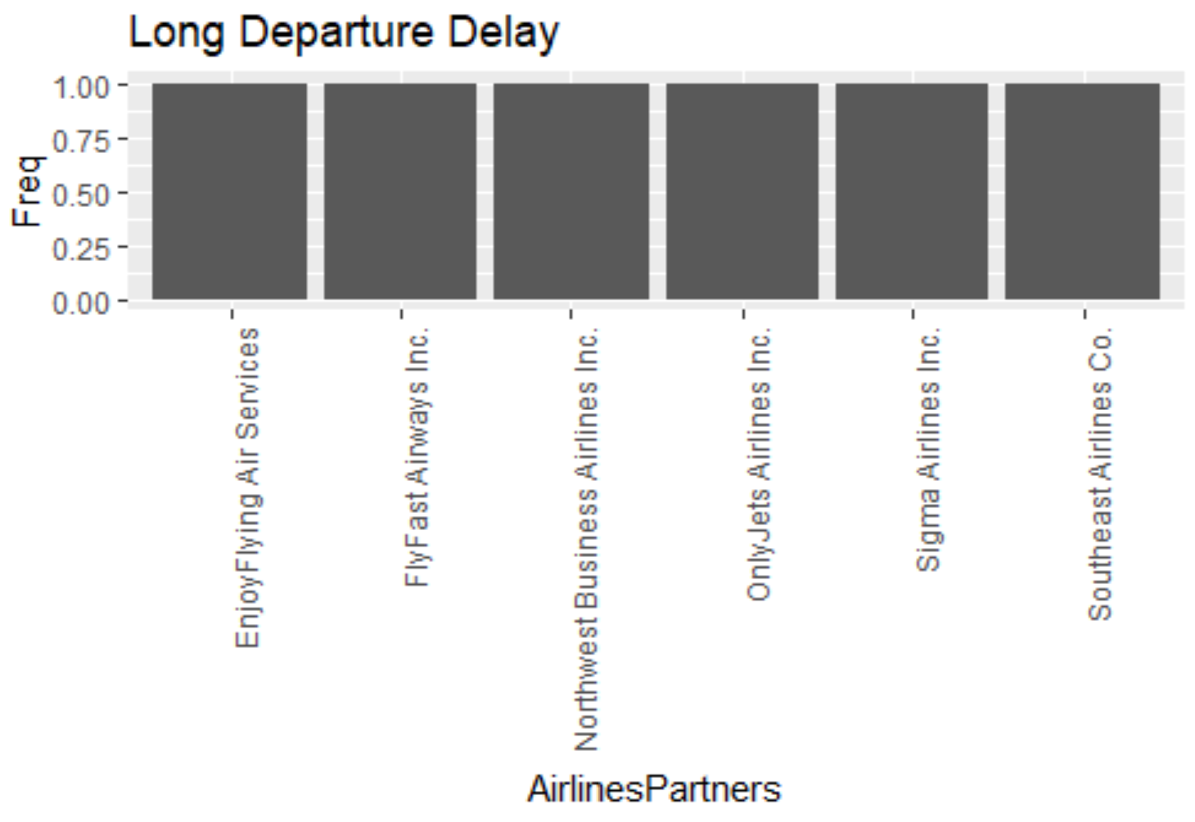
DATA DESCRIPTIONS
Flight Experience Attributes: Partner Airlines,Arrival Delay and Departure Delay

Slide 11
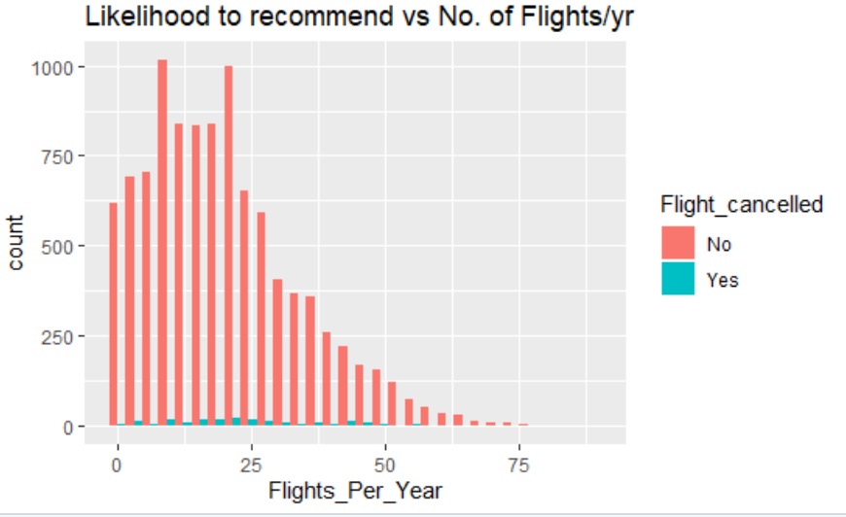
DATA DESCRIPTORS
Flight Attributes : Cancelled flight and likelihood to recommend.

Slide 12
Analysis Model 1
We used various attributes for creating a model.
Destination City
Origin City
Airline Status
Gender
Type of Travel
Class
Origin State
Destination State
Flight cancelled
Age Category
Passenger Category
Partner Name

Slide 13
Analysis Model 1
Out of these, based on significance we decided to consider the following attributes for linear modelling
Age
Gender
Price Sensitivity
Loyality_Index
Arrival_delay
Class
Airline Status
Long_duration_flight
Partner_Airline

Slide 14
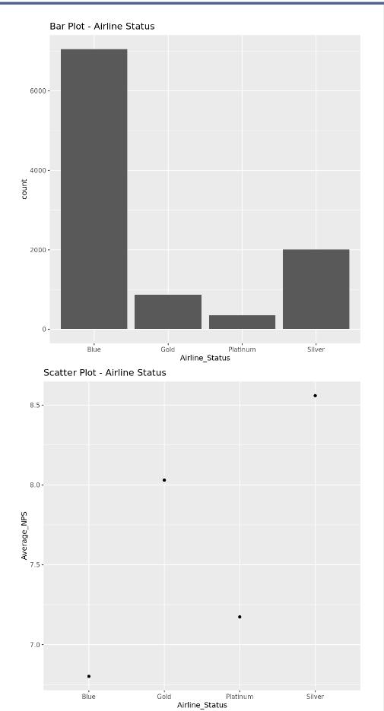
Analysis Model 1
Airline Status
Majority of airline customers - Blue Member
Blue Member - Lowest Average NPS

Slide 15
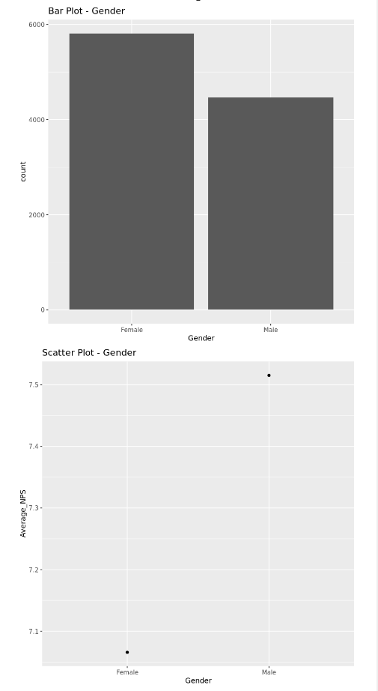
Analysis Model 1
Gender
Female Customers - Almost 1500 more than Male Customers
Lowest NPS Value - Female

Slide 16
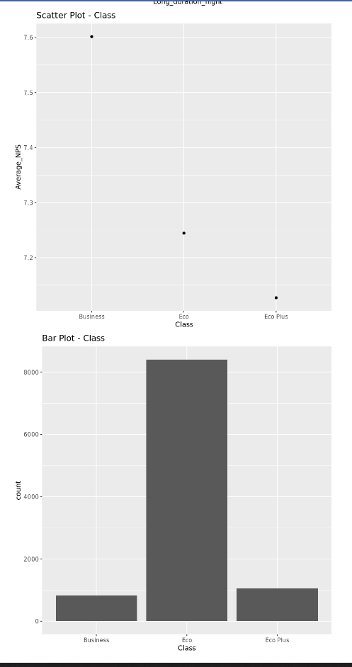
Analysis Model 1
Class
Business Class - Least number of People but highest Average NPS
Eco Class - HIghest number of People but Low Average NPS

Slide 17
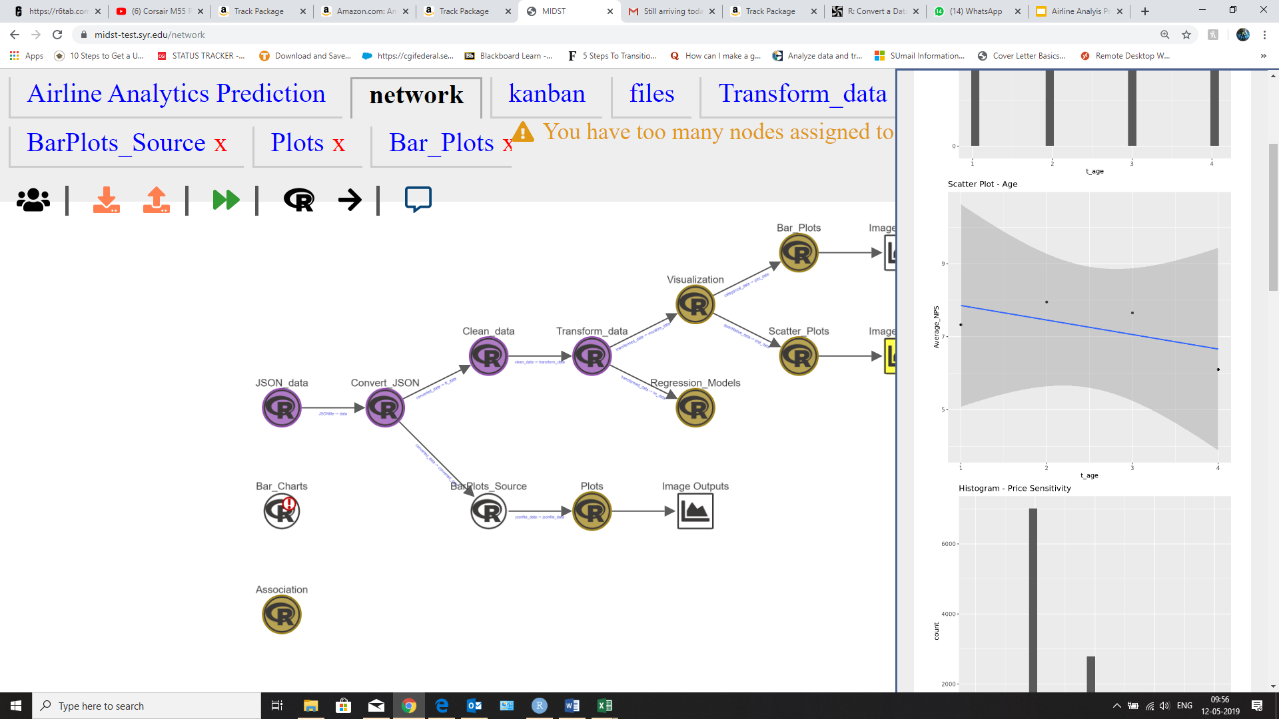
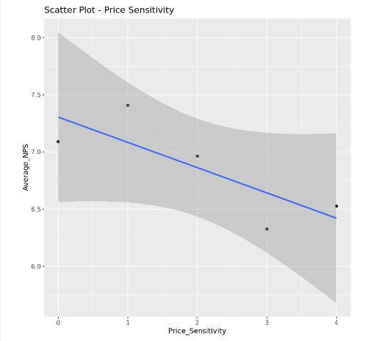
Analysis Model 1

Slide 18
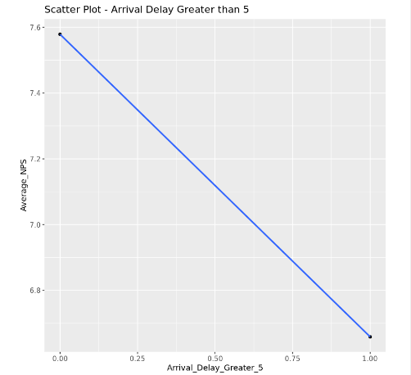
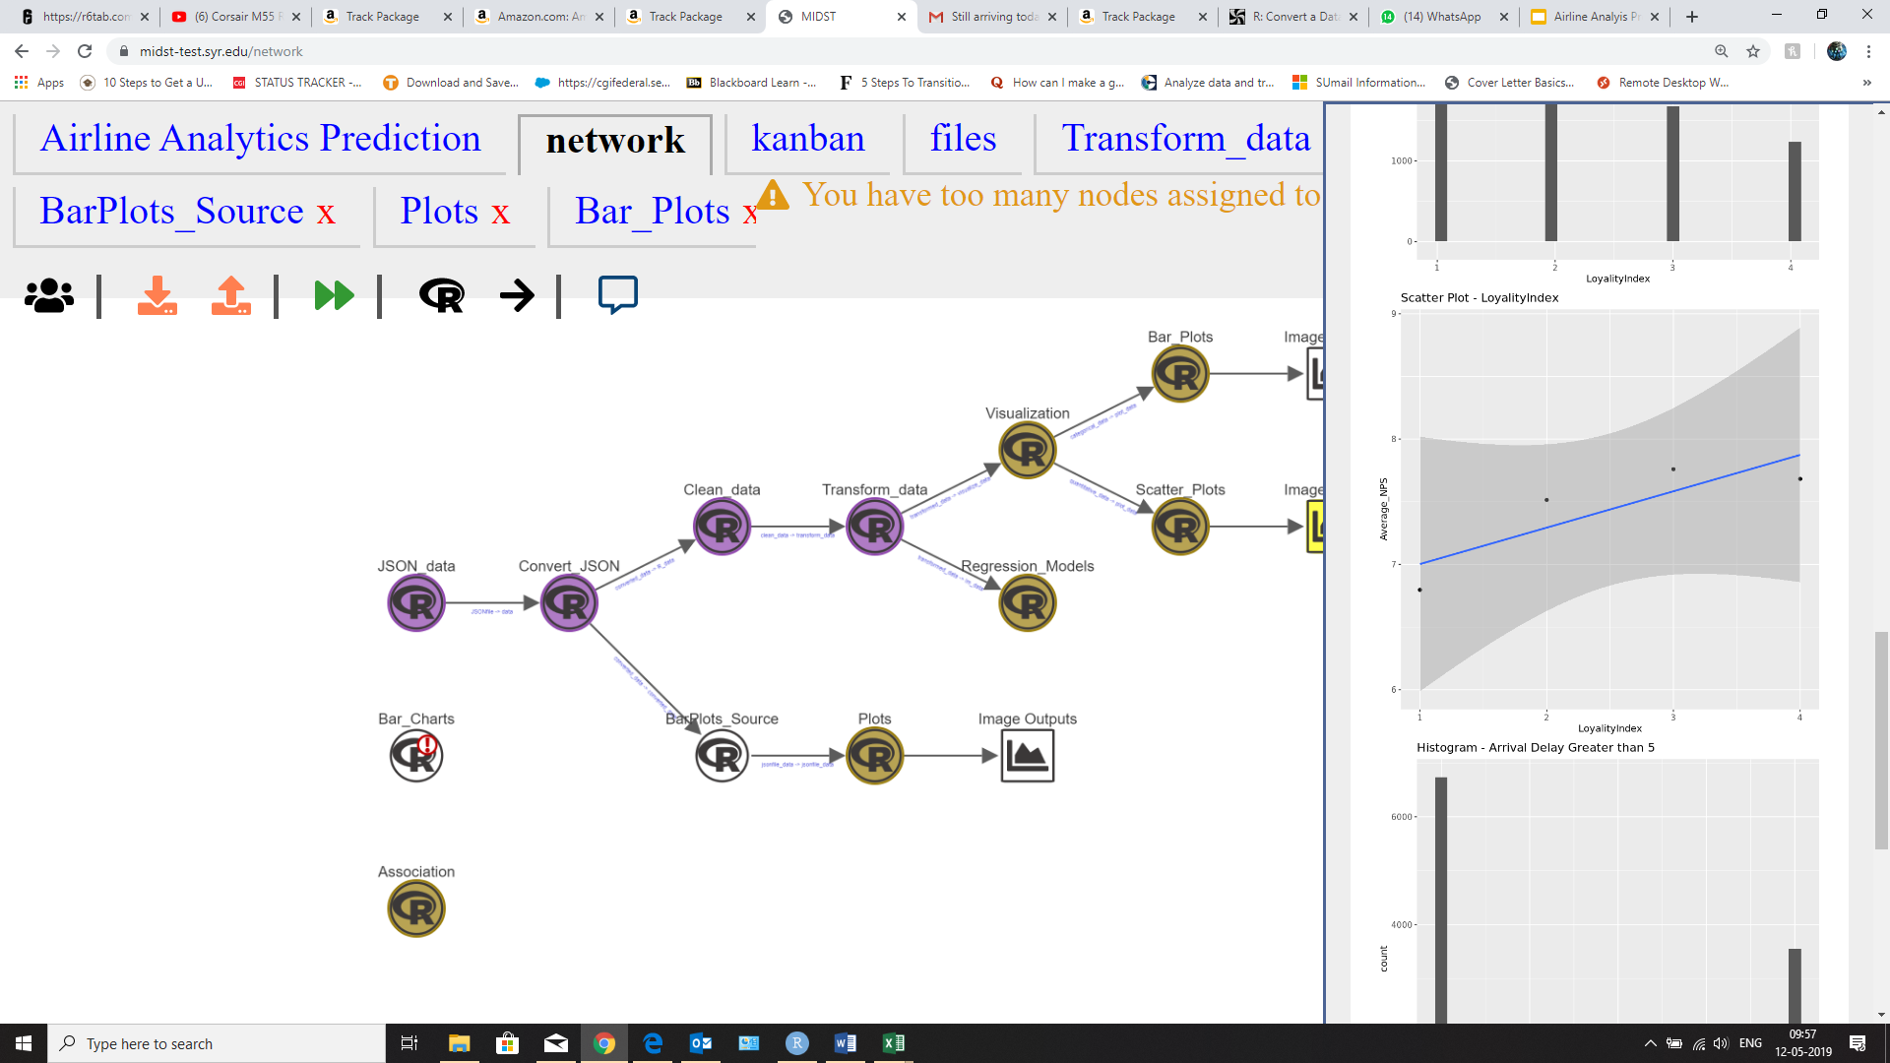
Analysis Model 1

Slide 19
Analysis Model 1
According to our model, looks like
Unhappy Customers are
Female Customers, Blue Airline Status, Economy class travellers & Adult People (Age > 60)

Slide 20
Analysis Model 1
According to our model, looks like
Happy Customers are
Male Customers, Platinum Status, Business class travellers & Young People (Age between 15 and 33)

Slide 21
Analysis Model 1
According to our model, looks like
A Successful Flight Experience is defined by
Flight with Arrival_delay no greater than 5 minutes
Flight with no long Duration of flight

Slide 22
Analysis Model 1
Out of these, based on significance we decided to consider the following attributes for linear modelling
Age
Gender
Price Sensitivity
Loyality_Index

Slide 23
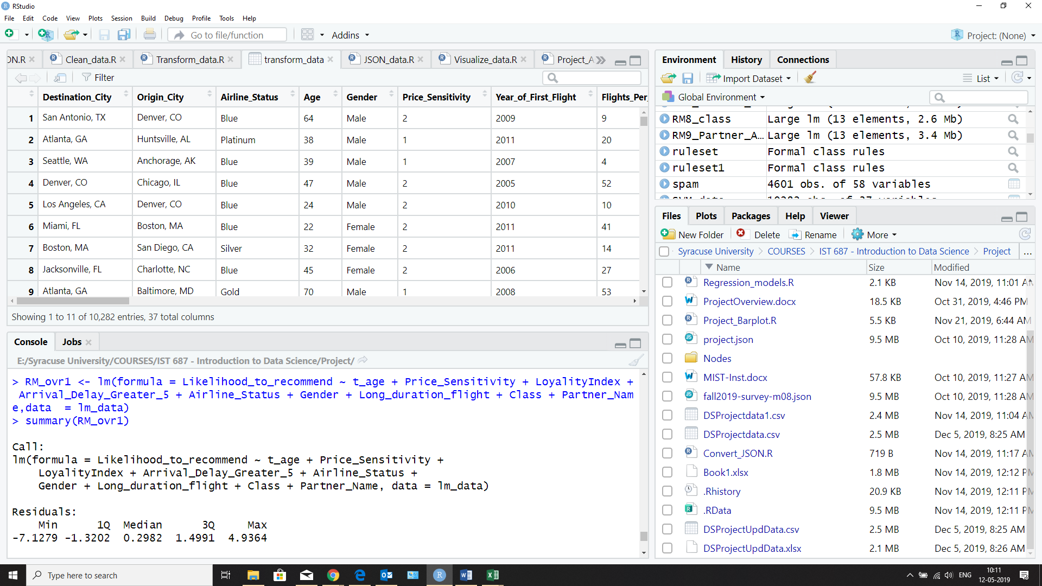
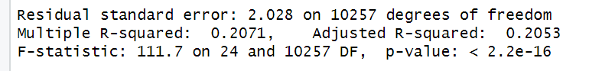
Analysis Model 1
Using the Attributes specified
We were able to predict about the 20% change in Likelihood_to_recommend

Slide 24
Analysis Model 2
We used various attributes for creating a model.
Destination City
Origin City
Airline Status
Gender
Type of Travel
Class
Origin State
Destination State
Flight cancelled
Age Category
Passenger Category
Partner Name

Slide 25
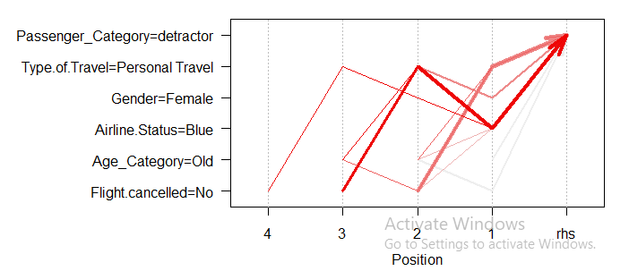
Analysis Model 2

Slide 26
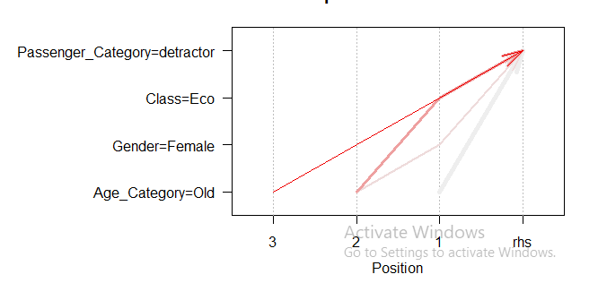
Analysis Model 2
We further reduced the variables to Class,Gender,Partner Name,Age Category,Passenger Category

Slide 27
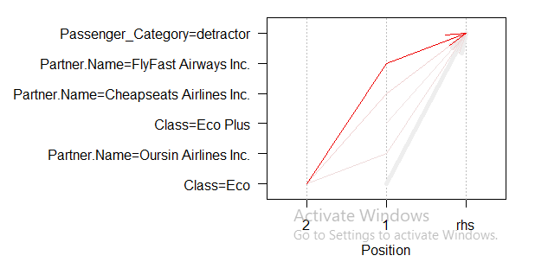
Analysis Model 2
We further considered Partner Airlines,Class and Passenger Category variables only.

Slide 28
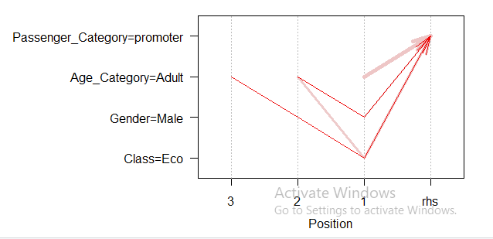
Analysis Model 2
We further considered variables for promoters as Class,Gender,Partner Name,Age Category,Passenger Category

Slide 29
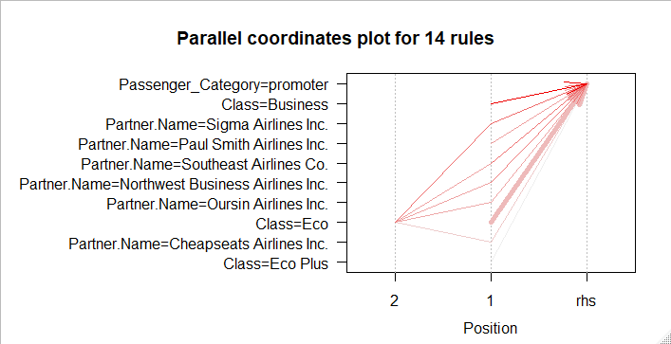
Analysis Model 2
We now consider variables for promoters as Class,Partner Name,Passenger Category for further analysis.

Slide 30
Analysis Model 3 (Support Vector Machines)
Analysed for 3 different conditions : Gender, Airline Partner Name and Departure Delay.
The error rate of the analysis was too high to get a proper prediction.
Thus, SVM is not suitable for large datasets because of its high training time.

Slide 31
Insights and Recommendation
Following points can help in customer satisfaction:
Services provided by Sigma Airlines for Eco class must be implemented by other airlines partners
Team should focus more on old female travelling by Eco Class through FlyFast Airlines
Customers travelling by Business Class and Male Adult by Eco Class must be encouraged to travel more frequently

Slide 32
Any Questions?

Slide 33
Thank You!

